Slide 1
Karnaugh map
Lecture 5
Prepared by : Eng.Amani Safwat

Slide 2
Introduction
A Karnaugh Map (K-map) is a graphical method used to simplify Boolean functions by organizing all possible combinations of variables in a visual grid. It helps to minimize logic expressions without using complex algebraic steps, making digital circuit design more efficient. Each cell in the map represents a minterm (for SOP) or maxterm (for POS),.
In short: K-maps make it easier to find simplified logic equations by grouping 1s or 0s in patterns of

Slide 3
Why Simplification
- To reduce the number of logic gates.
- To simplify circuit design.
- To save cost and power

Slide 4
K-map Layouts
- 2-variable: 4 cells
- 3-variable: 8 cells
- 4-variable: 16 cells

Slide 5
Karnaugh map
4 inputs
A
AB
 | 0 | 1
0 | 0 | 0
1 | 1 | 1
 | 00 | 01 | 11 | 10
00 | 1 | 0 | 0 | 1
01 | 0 | 0 | 0 | 0
11 | 0 | 0 | 0 | 0
10 | 1 | 0 | 0 | 1
→ GARY CODE
B
CD
2 inputs
→ GARY CODE
AB
 | 00 | 01 | 11 | 10
0 | 1 | 0 | 0 | 1
1 | 1 | 0 | 0 | 1
C
implicant
2^{n} = n (1,2,3,4,…)
3 inputs

Slide 6
Simplification Steps
1. Draw K-map
2. Fill cells with 1’s or 0
3. Group adjacent 1’s (1,2,4,8,…)
4. Write the simplified equation

Slide 7
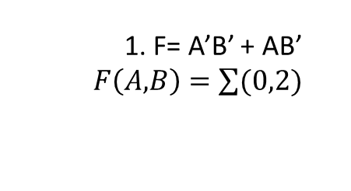
Two Variables
Apply the Karnaugh map to the following table:
A.
A | B | F
0 | 0 | 1
0 | 1 | 0
1 | 0 | 1
1 | 1 | 0
A
 | 0 | 1
0 | 1 | 1
1 | 0 | 0
1. F= A’B’ + AB’
$F\left(A,B\right)=\sum{(0,2)}$
B
=B’
→
→
F= B’

Slide 8
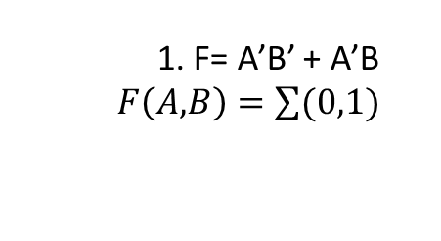
Two Variables
Apply the Karnaugh map to the following table:
B.
A | B | F
0 | 0 | 1
0 | 1 | 1
1 | 0 | 0
1 | 1 | 0
A
 | 0 | 1
0 | 1 | 0
1 | 1 | 0
1. F= A’B’ + A’B
$F\left(A,B\right)=\sum{(0,1)}$
B
→
= A’
F= A’

Slide 9
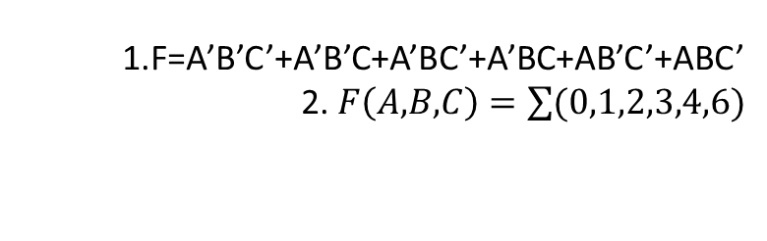
Three Variables
Apply the Karnaugh map to the following table:
A | B | C | F
0 | 0 | 0 | 1
0 | 0 | 1 | 1
0 | 1 | 0 | 1
0 | 1 | 1 | 1
1 | 0 | 0 | 1
1 | 0 | 1 | 0
1 | 1 | 0 | 1
1 | 1 | 1 | 0
1.F=A’B’C’+A’B’C+A’BC’+A’BC+AB’C’+ABC’
2. $F\left(A,B,C\right)=\sum{(0,1,2,3,4,6)}$
→
→
AB
 | 00 | 01 | 11 | 10
0 | 1 | 1 | 1 | 1
1 | 1 | 1 | 0 | 0
C
= C’
3.
=A’
F= A’ +C’

Slide 10
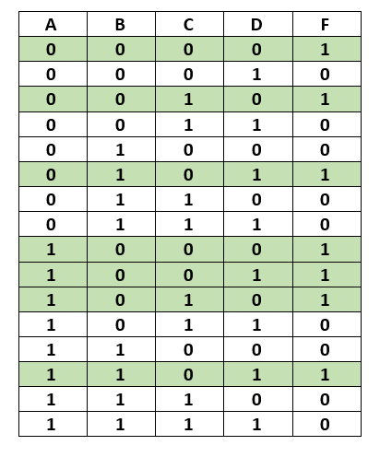
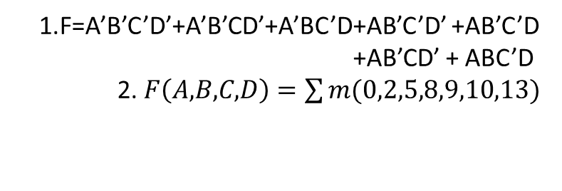
four Variables
Apply the Karnaugh map to the following table:
1.F=A’B’C’D’+A’B’CD’+A’BC’D+AB’C’D’ +AB’C’D +AB’CD’ + ABC’D
2. $F\left(A,B,C,D\right)=\sum{m(0,2,5,8,9,10,13)}$
→
AB
AB’C’
 | 00 | 01 | 11 | 10
00 | 1 | 0 | 0 | 1
01 | 0 | 1 | 1 | 1
11 | 0 | 0 | 0 | 0
10 | 1 | 0 | 0 | 1
CD
3.
BC’D
B’D’
F= BC’D+B’D’ +AB’C’

Slide 11
Exercise
Apply the Karnaugh map to the following table:
A | B | F
0 | 0 | 1
0 | 1 | 0
1 | 0 | 1
1 | 1 | 1

Slide 12

Answer
Apply the Karnaugh map to the following table:
A | B | F
0 | 0 | 1
0 | 1 | 0
1 | 0 | 1
1 | 1 | 1
A
 | 0 | 1
0 | 1 | 1
1 | 0 | 1
1. F= A’B’ + AB’ + AB
$$F\left(A,B\right)=\sum{(0,2,3)}$$
B
=B’
=A
F= A’B’ + AB’ + AB= >A+B’
So F = A+B`

